Slide 1
MATLAB FOR ROBOT VISION

Slide 2
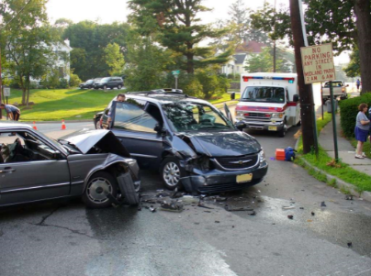
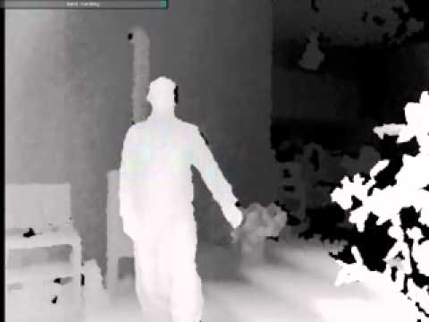
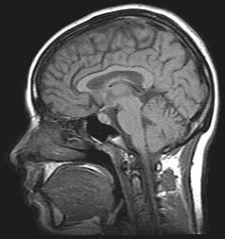
What is Computer Vision?
Computer vision is the science and technology of machines that see.
Concerned with the theory for building artificial systems that obtain information from images.
The image data can take many forms, such as a video sequence, depth images, views from multiple cameras, or multi-dimensional data from a medical scanner
Notes:
2

Slide 3
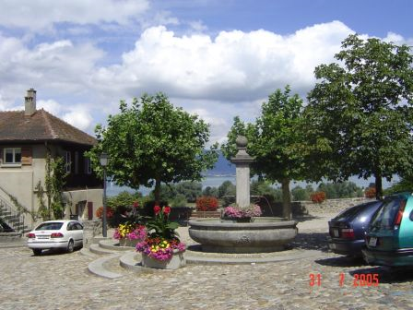
Computer Vision
Make computers understand images and videos.
What kind of scene?
Where are the cars?
How far is the building?
…

Slide 4
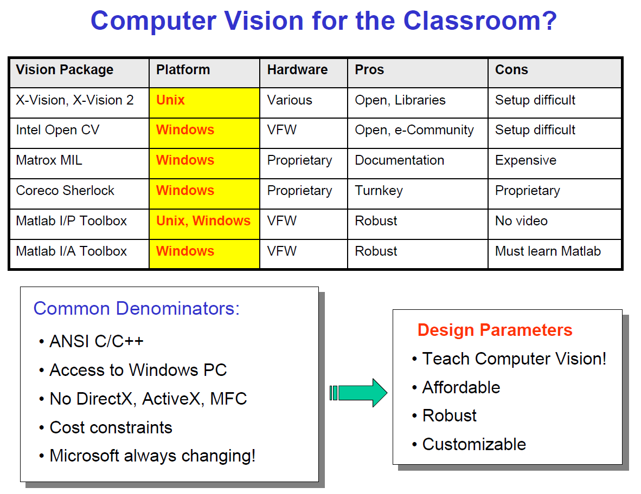
Recently improved

Slide 5
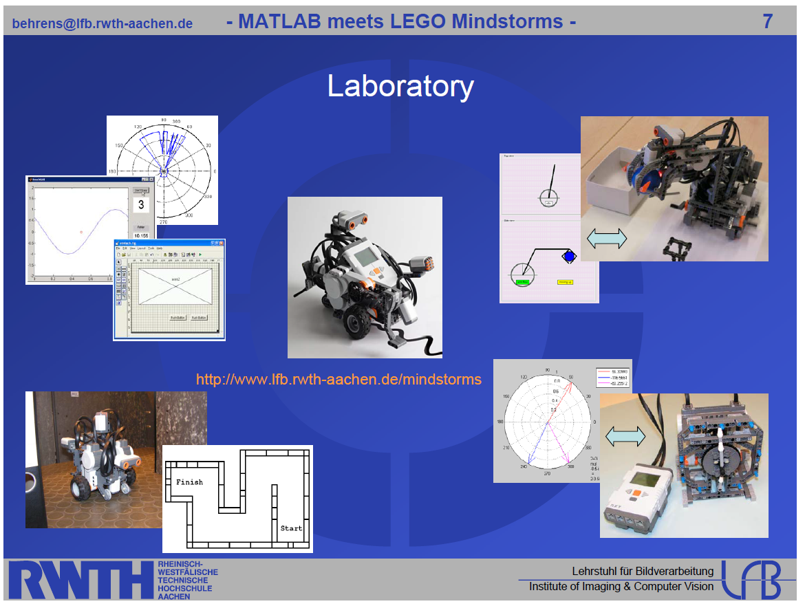

Slide 6

Components of a computer vision system
Camera
Lighting
Computer
Scene
Scene Interpretation
Srinivasa Narasimhan’s slide

Slide 7

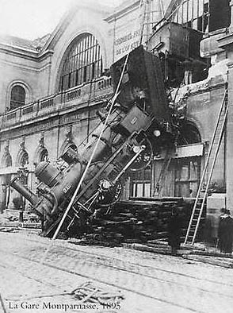
Computer vision vs human vision
What we see
What a computer sees

Slide 8
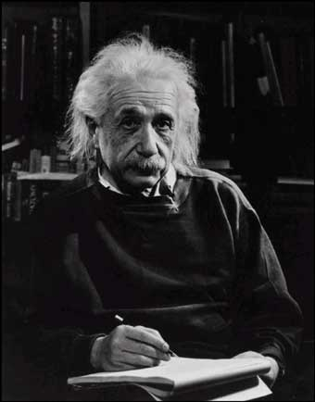
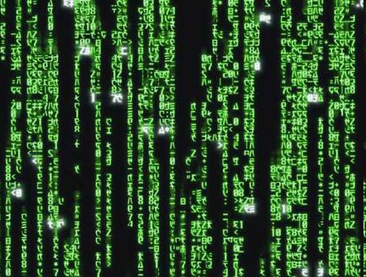
Computer Vision
What we see
What a computer sees

Slide 9
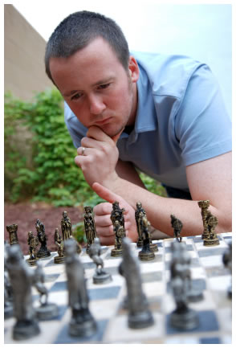
Vision is really hard
Vision is an amazing feat of natural intelligence
  Visual cortex occupies about 50% of Macaque brain
  More human brain devoted to vision than anything else
Is that a queen or a bishop?

Slide 10

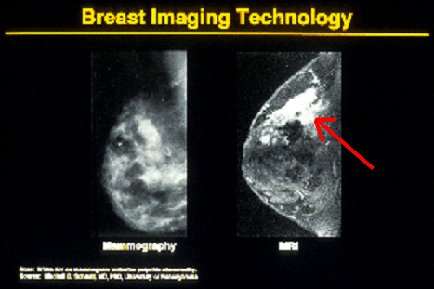

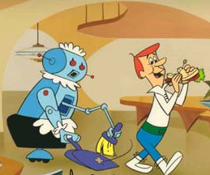
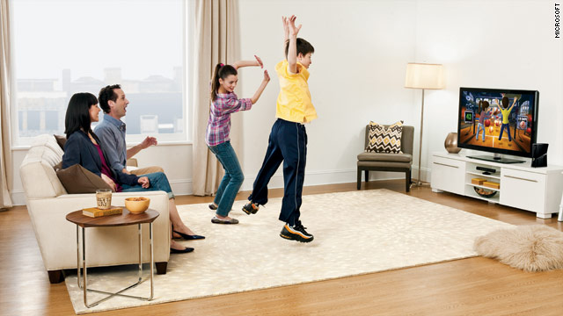
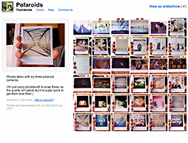
Why computer vision matters
Safety
Health
Security
Comfort
Fun
Access

Slide 11
A little story about Computer Vision
In 1966, Marvin Minsky at MIT asked his undergraduate student Gerald Jay Sussman to “spend the summer linking a camera to a
computer and getting the computer to describe what it saw”. We now know that the problem is slightly more difficult than that. (Szeliski 2009, Computer Vision)
Image Understanding

Slide 12
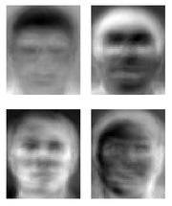
Ridiculously brief history of computer vision
1966: Minsky assigns computer vision as an undergrad summer project
1960’s: interpretation of synthetic worlds
1970’s: some progress on interpreting selected images
1980’s: ANNs come and go; shift toward geometry and increased mathematical rigor
1990’s: face recognition; statistical analysis in vogue
2000’s: broader recognition; large annotated datasets available; video processing starts; vision & graphis; vision for HCI; internet vision, etc.
Guzman ‘68
Ohta Kanade ‘78
Turk and Pentland ‘91

Slide 13
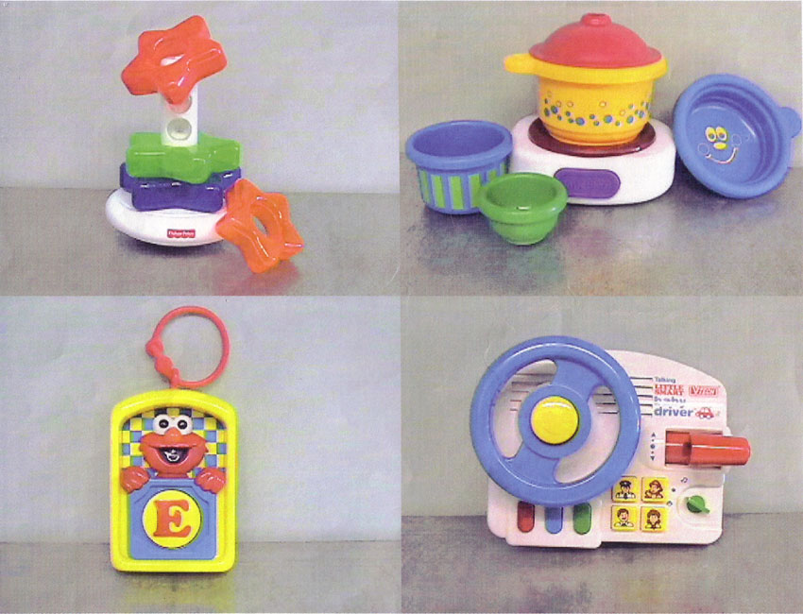
A Picture is Worth 100 Words

Slide 14
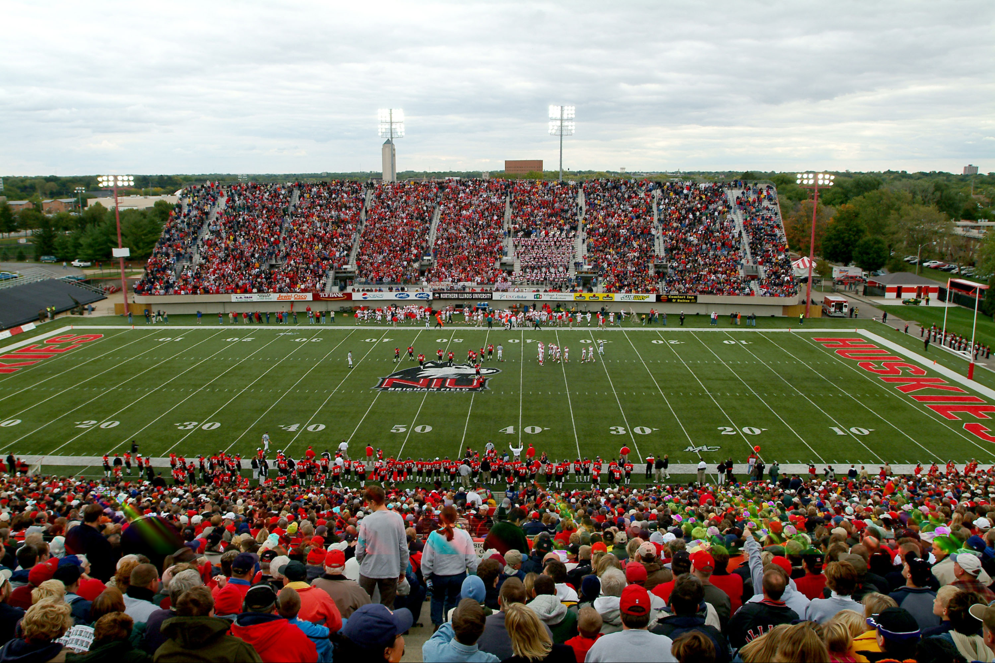
A Picture is Worth 10,000 Words

Slide 15
A Picture is Worth a Million Words

Slide 16
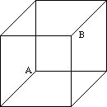
A Picture is Worth a ...?
Necker’s Cube Reversal

Slide 17
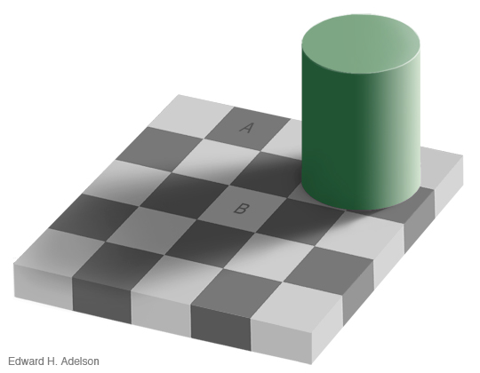
A Picture is Worth a ...?
Checker Shadow Illusion – [E. H. Adelson]

Slide 18
Human Vision
Can do amazing things like:
  Recognize people and objects
  Navigate through obstacles
  Understand mood in the scene
  Imagine stories
But still is not perfect:
  Suffers from Illusions
  Ignores many details
  Ambiguous description of the world
  Doesn’t care about accuracy of world

Slide 19
What is Computer Vision?
Inverse Optics
Intelligent interpretation of Imagery
Building a Visual Cortex
No matter what your definition is…
  Vision is hard.
  But is fun...

Slide 20
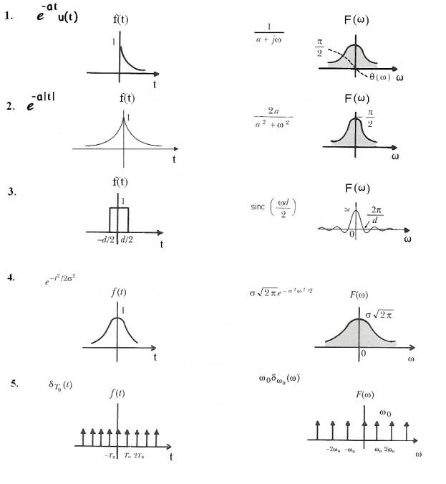
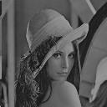
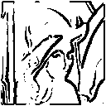
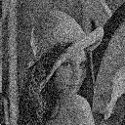

Image Processing
Image enhancement
Feature detection
Fourier Transform
Sampling, Convolution

Slide 21
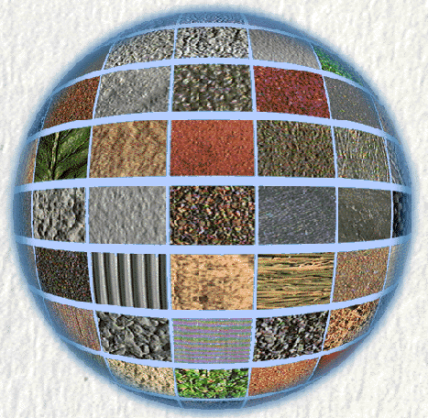
Surface Reflectance
[CURET]

Slide 22
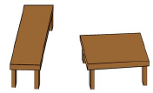
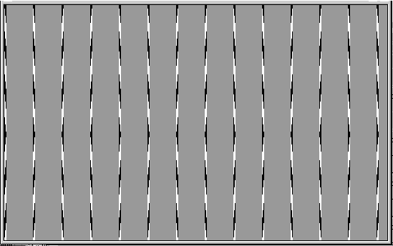
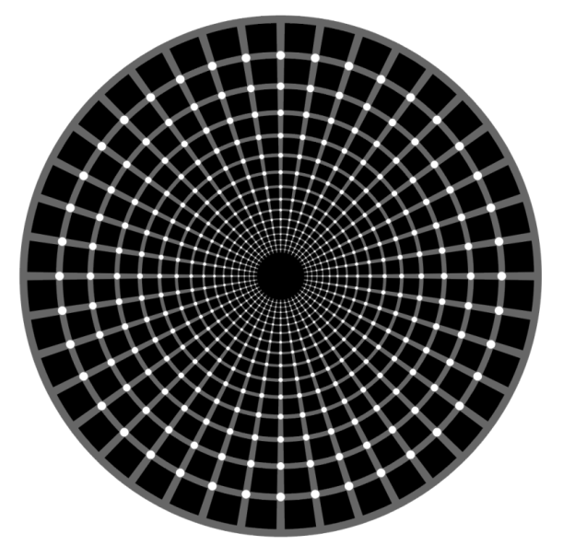
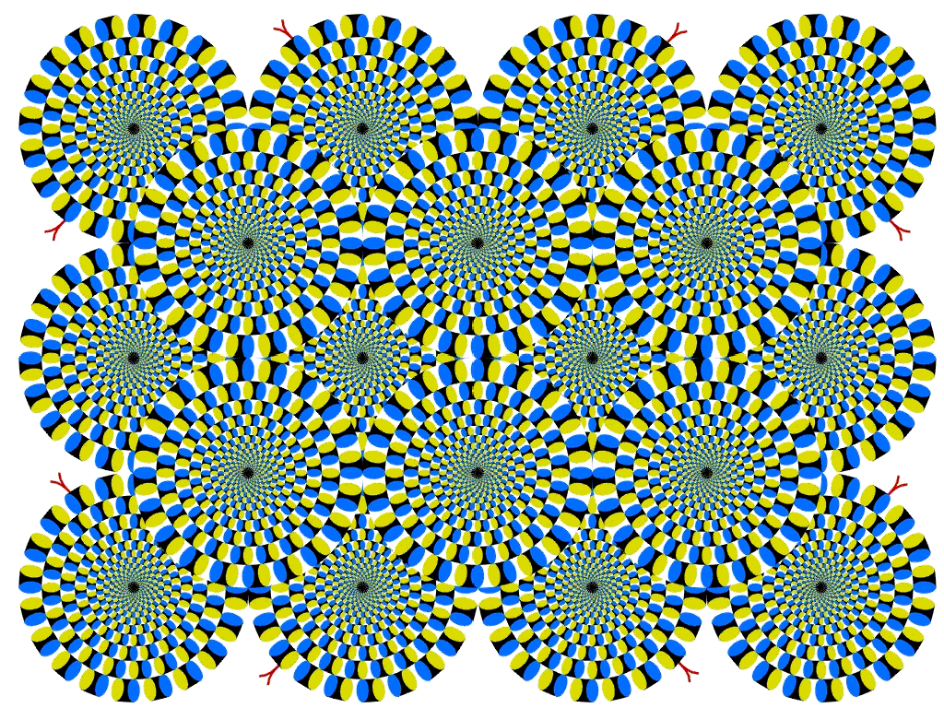
Understanding Optical Illusions
Which is bigger?
Straight Lines?
Dots White? Or Black?
Spinning Wheels?

Slide 23
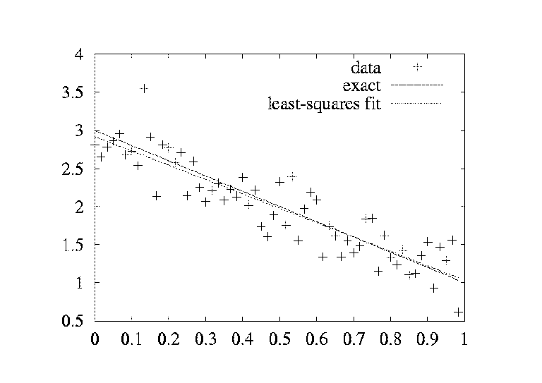
Statistical Techniques
Least Squares Fitting

Slide 24
IMAGE ACQUISITION

Slide 25
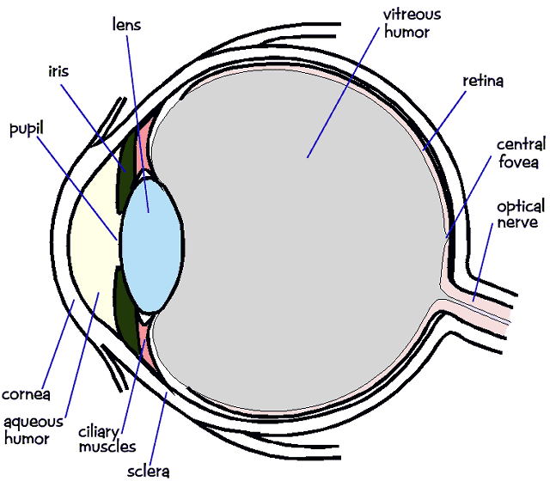
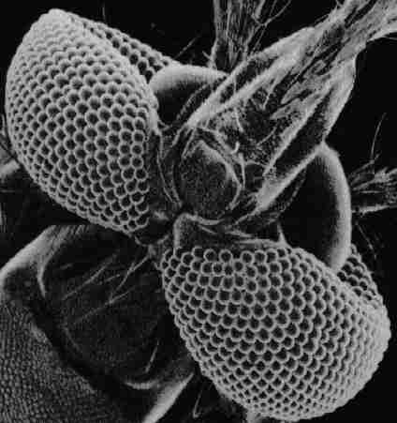
Biological Cameras
Human Eye
Mosquito Eye

Slide 26
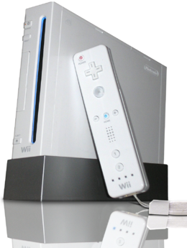
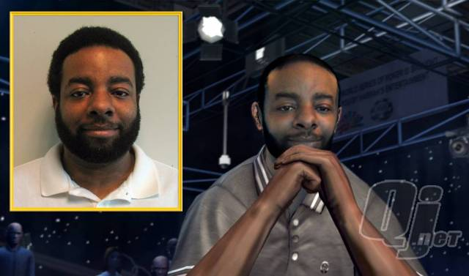
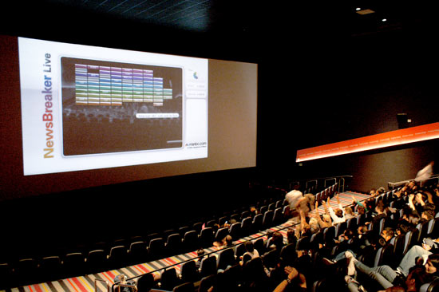
Vision-based interaction (and games)
Digimask: put your face on a 3D avatar.
Nintendo Wii has camera-based IR
tracking built in. See Lee’s work at
CMU on clever tricks on using it to
create a multi-touch display!
“Game turns moviegoers into Human Joysticks”, CNET
Camera tracking a crowd, based on this work.

Slide 27
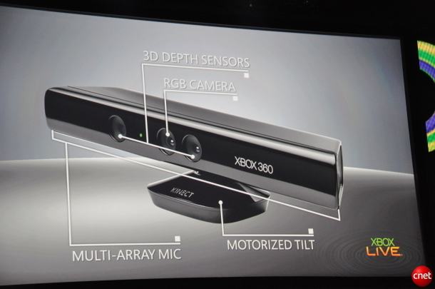
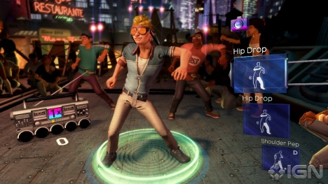
Interactive Games: Kinect
Object Recognition: http://www.youtube.com/watch?feature=iv&v=fQ59dXOo63o
Mario: http://www.youtube.com/watch?v=8CTJL5lUjHg
3D: http://www.youtube.com/watch?v=7QrnwoO1-8A
Robot: http://www.youtube.com/watch?v=w8BmgtMKFbY
3D tracking, reconstruction, and interaction: http://research.microsoft.com/en-us/projects/surfacerecon/default.aspx

Slide 28
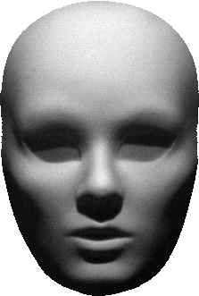


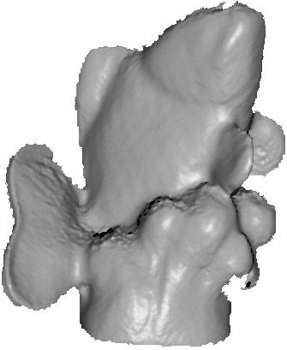
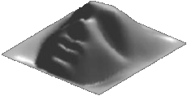
3D from Shading
Shape from Shading
Photometric Stereo

Slide 29
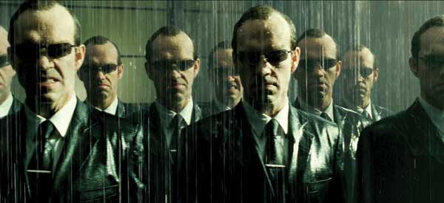
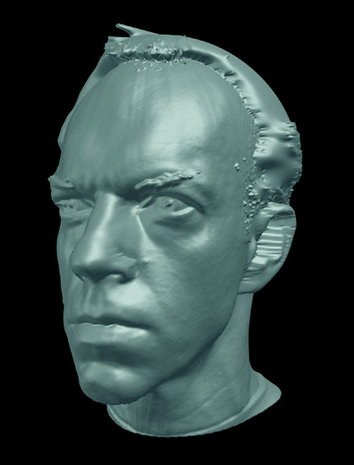
Special effects: shape capture
The Matrix movies, ESC Entertainment, XYZRGB, NRC

Slide 30
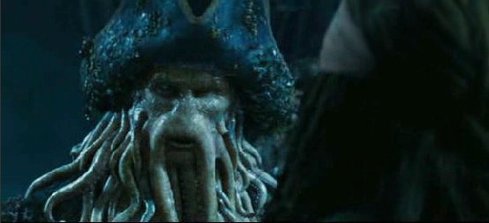
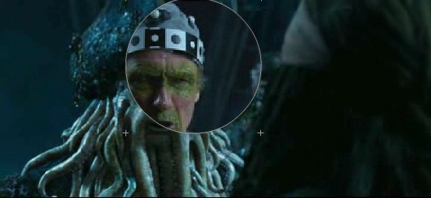
Special effects: motion capture
Pirates of the Carribean, Industrial Light and Magic

Slide 31
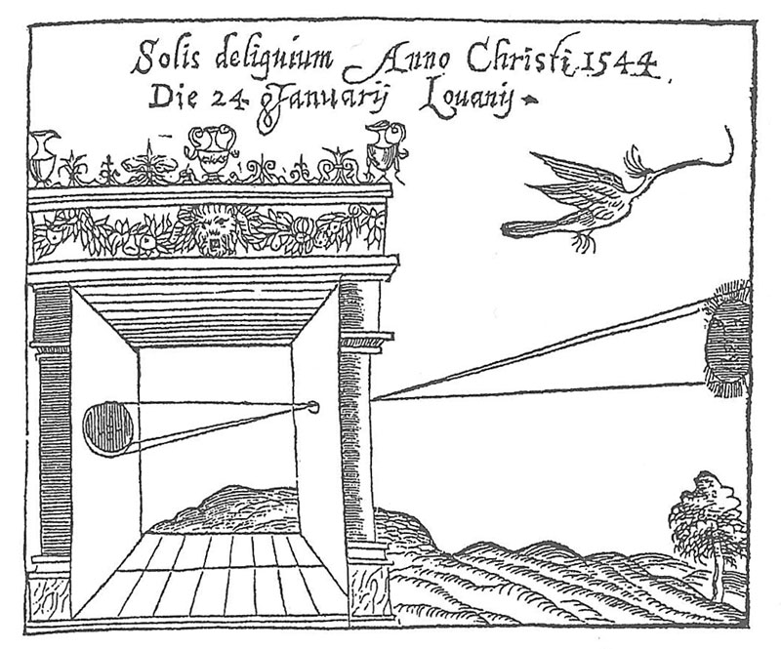
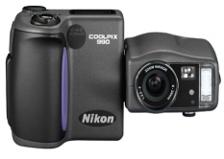
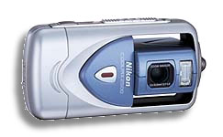
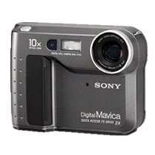
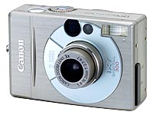
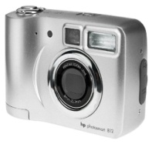
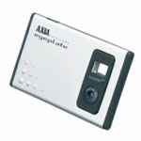



Cameras and their Optics
Today’s Digital Cameras
The Camera Obscura

Slide 32


Optical Flow

Slide 33


Binocular Stereo

Slide 34

Range Scanning and Structured Light

Slide 35


Range Scanning and Structured Light

Slide 36

Microsoft Kinect
IR LED Emitter
IR Camera
RGB Camera

Slide 37








Some Recent Trends in Vision
Novel Cameras and Displays
*** Topics change every year

Slide 38
MATLAB FOR VISION

Slide 39

Vision is multidisciplinary
Computer Graphics
HCI
From wiki

Slide 40

SOFTWARE TOOLS FOR VISION

Slide 41


Slide 42


Slide 43


Slide 44


Slide 45


Slide 46


Slide 47
SEGMENTATION

Slide 48


Slide 49


Slide 50


Slide 51


Slide 52


Slide 53


Slide 54


Slide 55


Slide 56


Slide 57


Slide 58
IMAGE REGISTRATION

Slide 59


Slide 60


Slide 61


Slide 62


Slide 63
FEATURE DETECTION

Slide 64


Slide 65


Slide 66


Slide 67


Slide 68
OBJECT DETECTION AND TRACKING

Slide 69


Slide 70


Slide 71

Object recognition (in supermarkets)
LaneHawk by EvolutionRobotics
“A smart camera is flush-mounted in the checkout lane, continuously watching for items.
When an item is detected and recognized, the cashier verifies the quantity of items that were found under the basket, and continues to close the transaction.
The item can remain under the basket, and with LaneHawk, you are assured to get paid for it… “

Slide 72
Face Detection, Face Recognition, People Detection and Foreground Detection

Slide 73

Face Detection, Face Recognition, People Detection and Foreground Detection

Slide 74

Face detection
Many new digital cameras now detect faces
  Canon, Sony, Fuji, …
Notes:
Why would this be useful? Main reason is focus. Also enables “smart” cropping.

Slide 75

Face Recognition
Principle Components Analysis (PCA)
Face Recognition

Slide 76
Smile detection
Sony Cyber-shot® T70 Digital Still Camera

Slide 77



Vision-based biometrics
“How the Afghan Girl was Identified by Her Iris Patterns” Read the story
wikipedia
Notes:
Age 12, Age 30,
The mathematical odds against such an event are 6 million to one for her right eye

Slide 78


Tracking

Slide 79


Slide 80


Slide 81

Bag of words for Category Classification

Slide 82


Slide 83
3D VISION

Slide 84


Slide 85


Slide 86


Slide 87


Slide 88
EMBEDDED APPLICATIONS

Slide 89


Slide 90


Slide 91


Slide 92


Slide 93


Medical imaging
3D imaging
MRI, CT
Image guided surgery
Grimson et al., MIT

Slide 94


Optical character recognition (OCR)
Technology to convert scanned docs to text
  If you have a scanner, it probably came with OCR software
Digit recognition, AT&T labs
http://www.research.att.com/~yann/
License plate readers
http://en.wikipedia.org/wiki/Automatic_number_plate_recognition

Slide 95




Login without a password…
Fingerprint scanners on many new laptops,
other devices
Face recognition systems now beginning to appear more widely
http://www.sensiblevision.com/

Slide 96

Object recognition (in mobile phones)
  Point & Find, Nokia
  Google Goggles

Slide 97

Sports
Sportvision first down line
Nice explanation on www.howstuffworks.com
http://www.sportvision.com/video.html
Notes:
Since 1998

Slide 98

Smart cars
Slide content courtesy of Amnon Shashua
Mobileye [wiki article]
  Vision systems currently in high-end BMW, GM, Volvo models
  By 2010: 70% of car manufacturers.

Slide 99

Google cars
http://www.nytimes.com/2010/10/10/science/10google.html?ref=artificialintelligence

Slide 100

Vision in space
NASA'S Mars Exploration Rover Spirit captured this westward view from atop
a low plateau where Spirit spent the closing months of 2007.
Vision systems (JPL) used for several tasks
  Panorama stitching
  3D terrain modeling
  Obstacle detection, position tracking
  For more, read “Computer Vision on Mars” by Matthies et al.

Slide 101


Industrial robots
Vision-guided robots position nut runners on wheels

Slide 102



Mobile robots
NASA’s Mars Spirit Rover
http://en.wikipedia.org/wiki/Spirit_rover
http://www.robocup.org/
Dipl.-Ing. Alexander Behrens
Saxena et al. 2008
STAIR at Stanford

Slide 103
Source
Jinxiang Chai
S. Narasimhan
Dr. Jasmina Lazic
Development of project exercises and new MATLAB toolbox
RWTH – Mindstorms NXT Toolbox for MATLAB

